Slide 1
Mathematic
Sumanas Chamneandamrongkarn
Grade 10 (2014-2015)

Slide 3
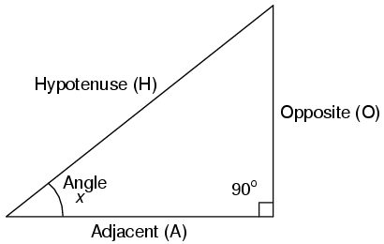
Trigonometry
How to find sin, cos, and tan
Sin(θ) = Opposite / Hypotenuse
Cos(θ) = Adjacent / Hypotenuse
Tan(θ) = Opposite / Adjacent
Degree - Radian

Slide 4
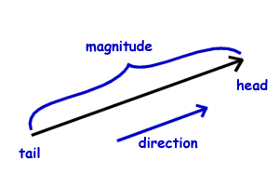
Vector
Speed- velocity
Magnitude- direction
Vector = magnitude + direction
Scalar = magnitude
describe by number

Slide 5
Quadratic Equation
factorization
${ax}^{2}+b^{2}+c=0$
$x=\frac{−b±\sqrt{b^{2}−4ac}}{2a}$
$b^{2}−4ac$
graph

Slide 6
Polynomial Identity
Division of polynomial
factor theorem

Slide 7
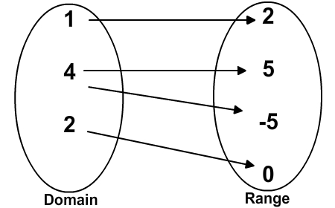
Relation and Function
Inverse function
Translation
Reflection
Stretches
Domain and range

Slide 8
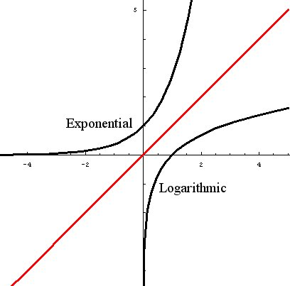
Exponential and Logarithm
Exponential equation
Properties of logarithm
$\log_{10}{=log}$
ln e
Law of logarithm

Slide 9
My Desmos work in Exponential and Logarithm unit.

Slide 10
Thank you

