Slide 1
DNA model
Palmy, Po, Pun, Ting 1001

Slide 2
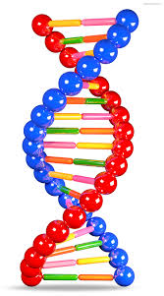
What is DNA?
DNA is DeoxyriboNucleic Acids
It forms in helix shape.
DNA is molecular blueprint of living things.
It is used to make different gene for every person.

Slide 3
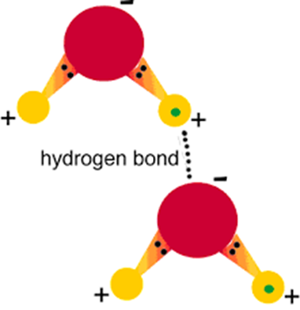
Hydrogen bonds
Is a bond that connect between Thymine, Adenine, Cytosine, and Guanine to make a DNA.

Slide 4
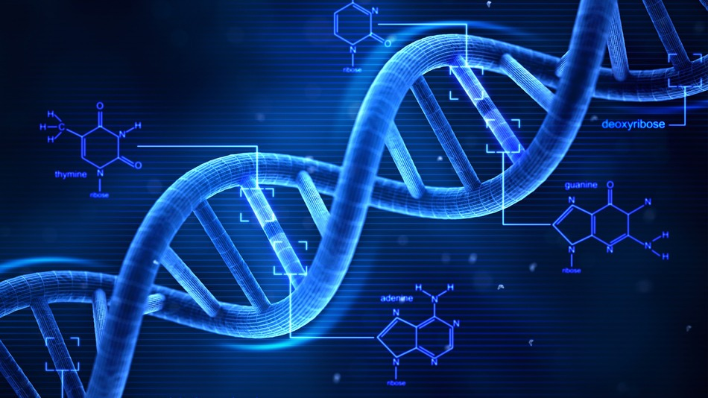
Structure
Thymine(T) - Blue
Adenine(A) - Orange
Cytosine(C) - Green
Guanine(G) - Dark green
Deoxyribose sugar - Silver
Phosphate - Pink
Hydrogen bond - small beads

Slide 5
Thank you for your Attention

