Slide 1
ALICE’s adventure in wonderland Poster reflection
By Sumanas Chamneandamrongkarn (Punpun) 10.1 no.1

Slide 2
Theme : Life is Chaos!

Slide 3
Creativity : Japanese Culture
- Every characters dress change into Japanese style dresses.
- The tea change into Japanese green tea.
- The white rabbit with the clock turns into the white rabbit that makes Moji(a kind of Japanese food)(one of Japanese culture is about the rabbit that live in the moon and makes Moji)
The queen of heart’s white roses turn into a white Sakura(Japanese cherry blossom) with a bit of red color that the card gardener try to paint the rose.

Slide 5
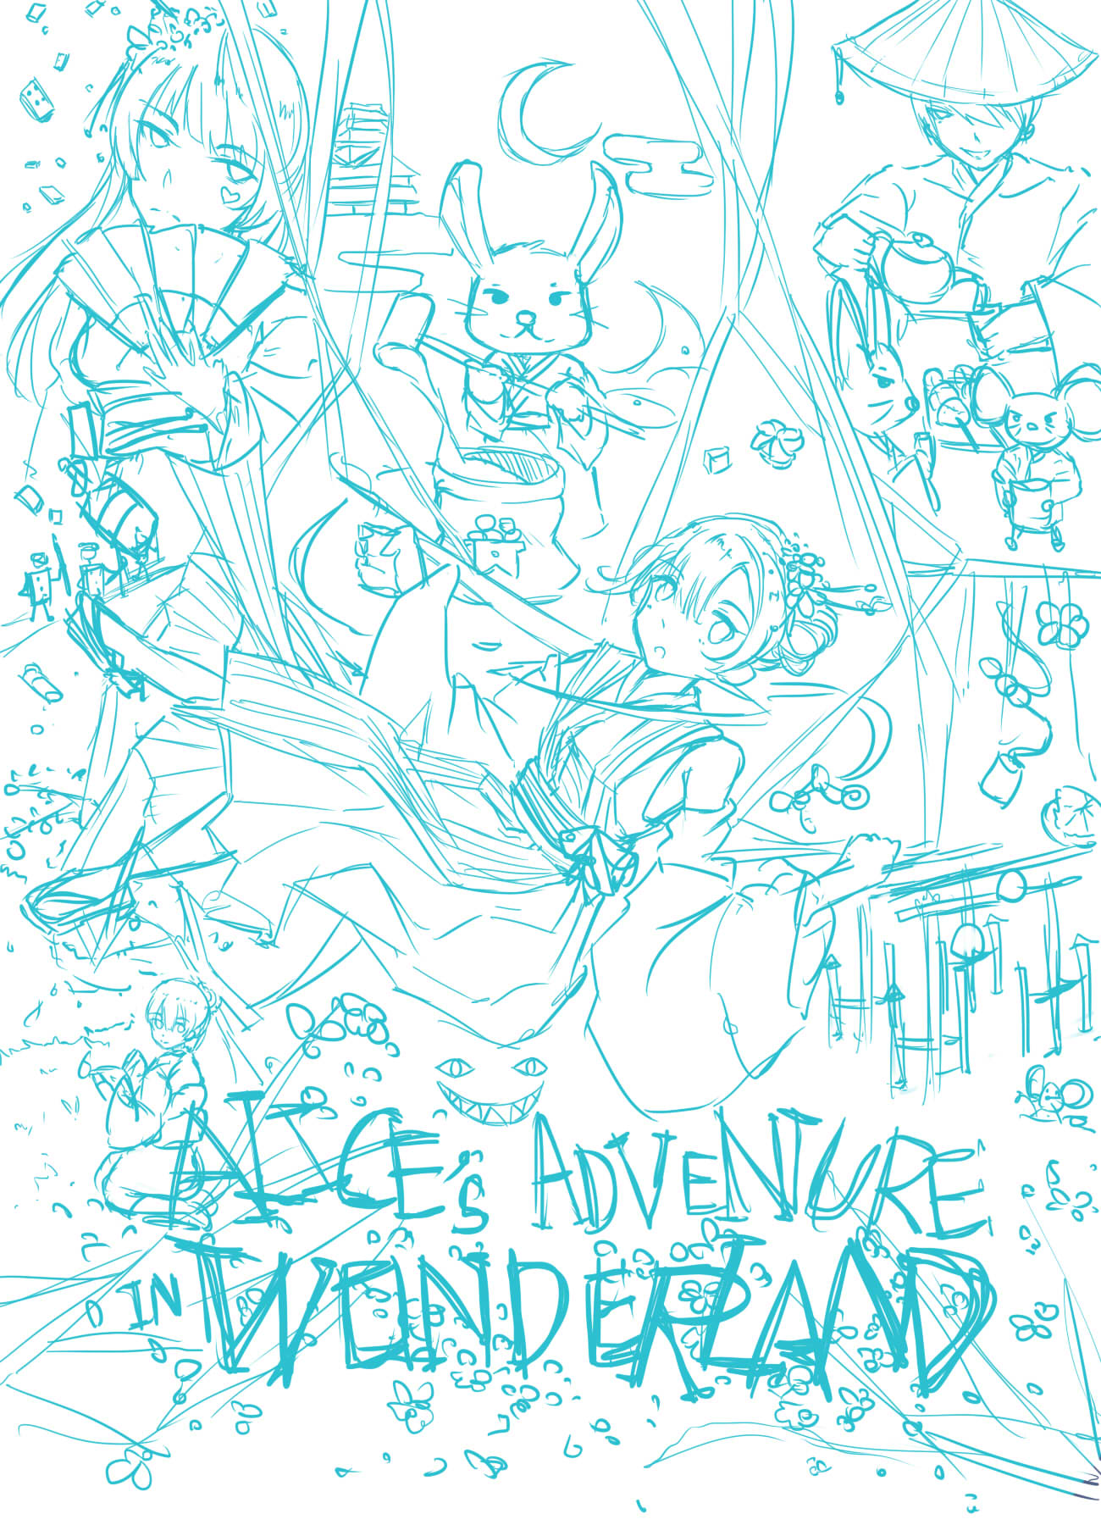
EFFORT
Week 1 : SKETCH

Slide 6
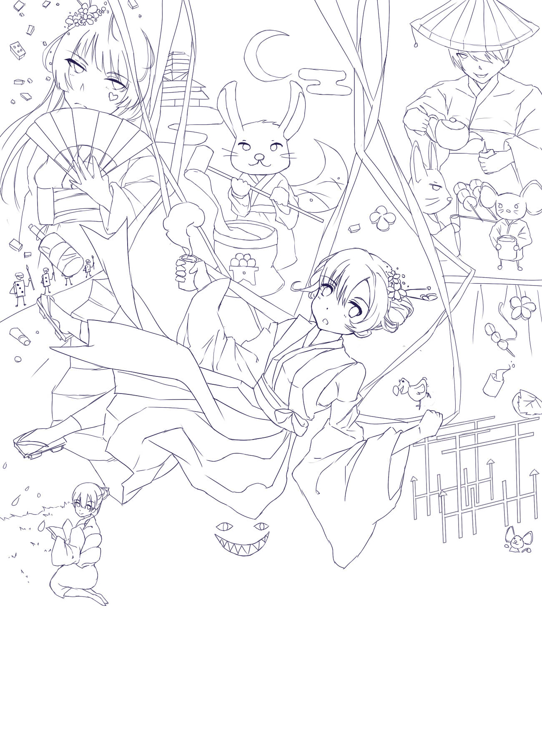
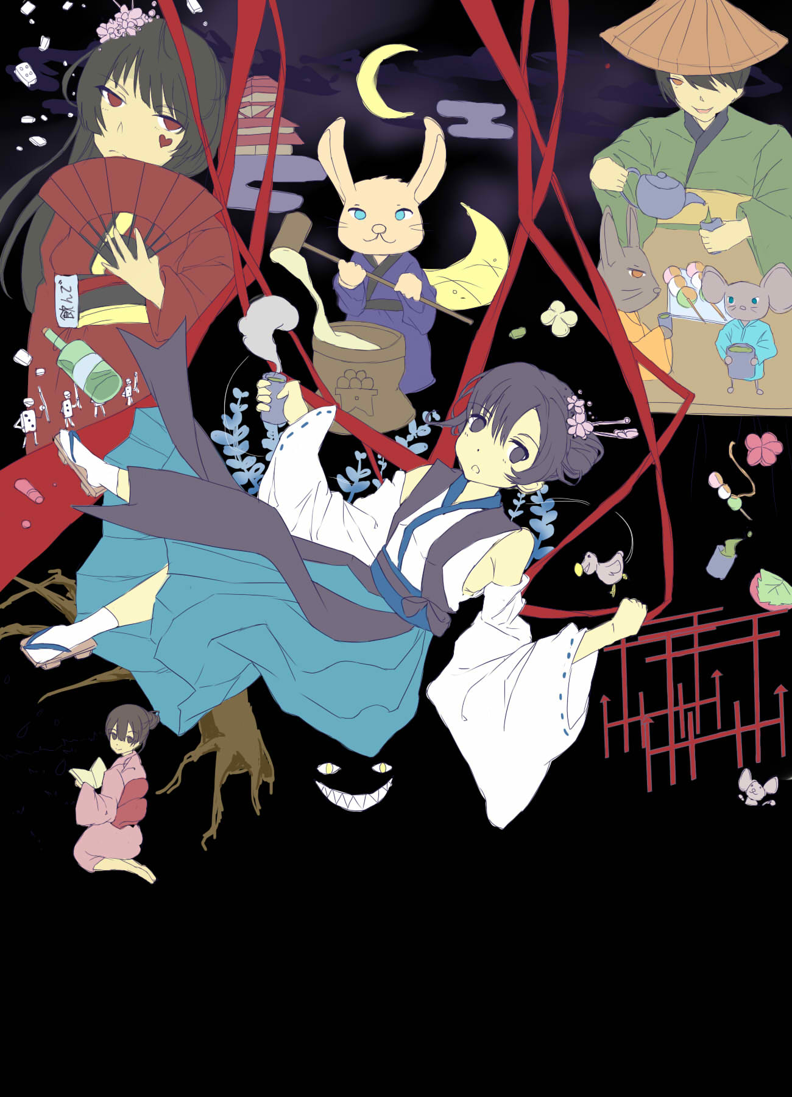
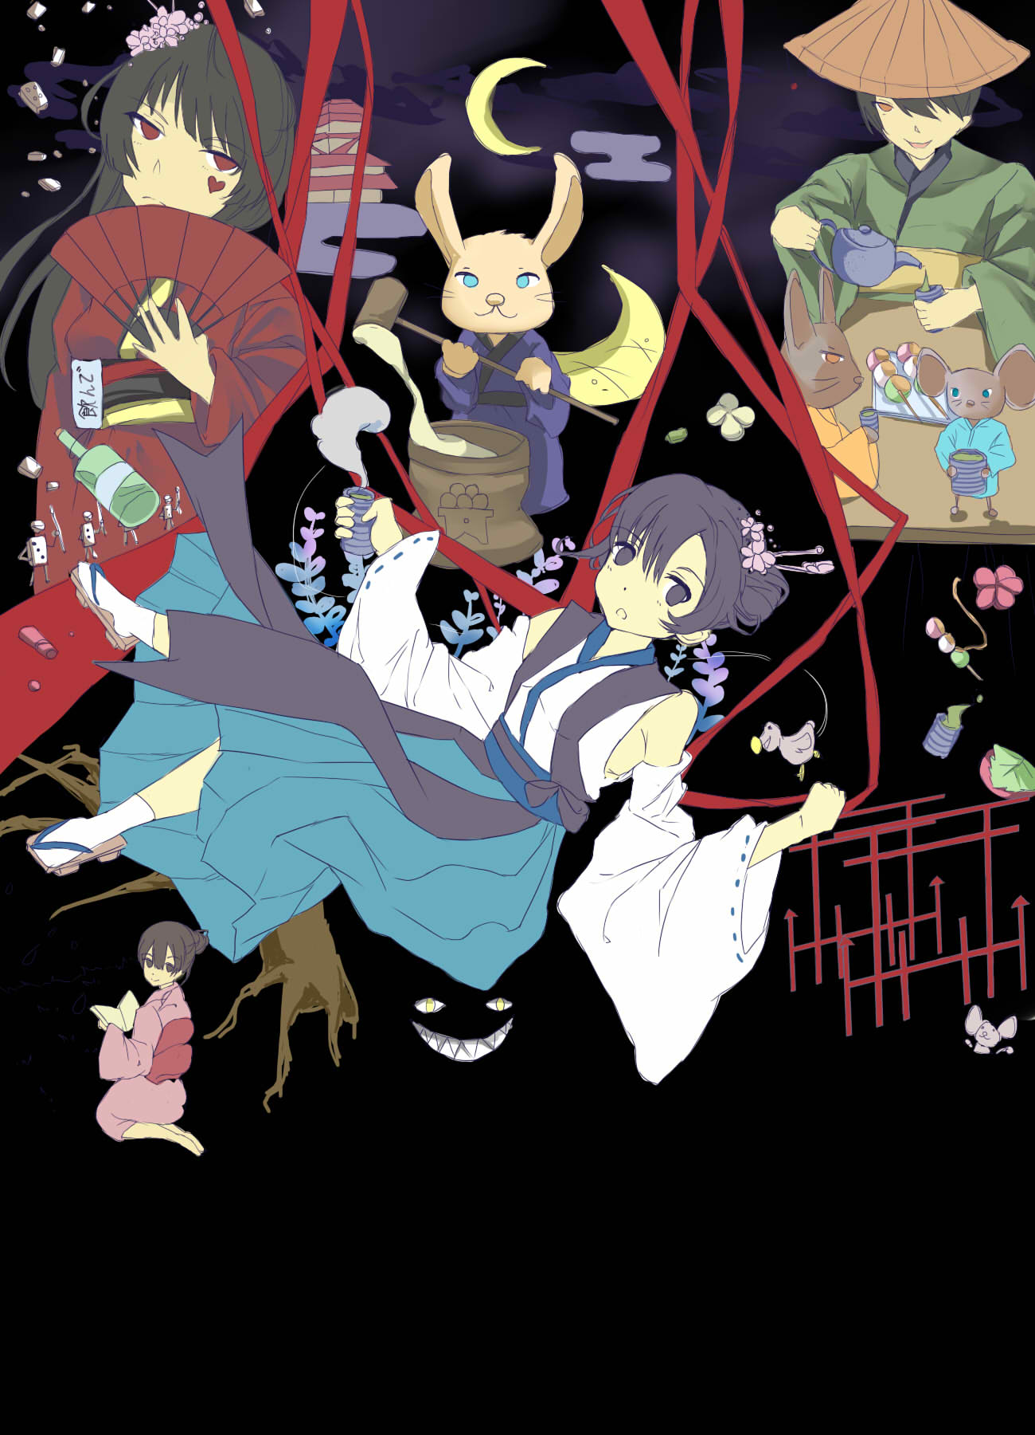
Week 2 : COLOR

Slide 8
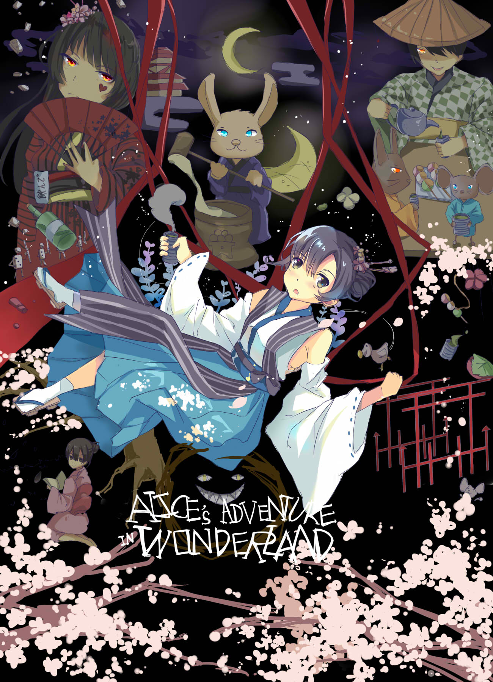
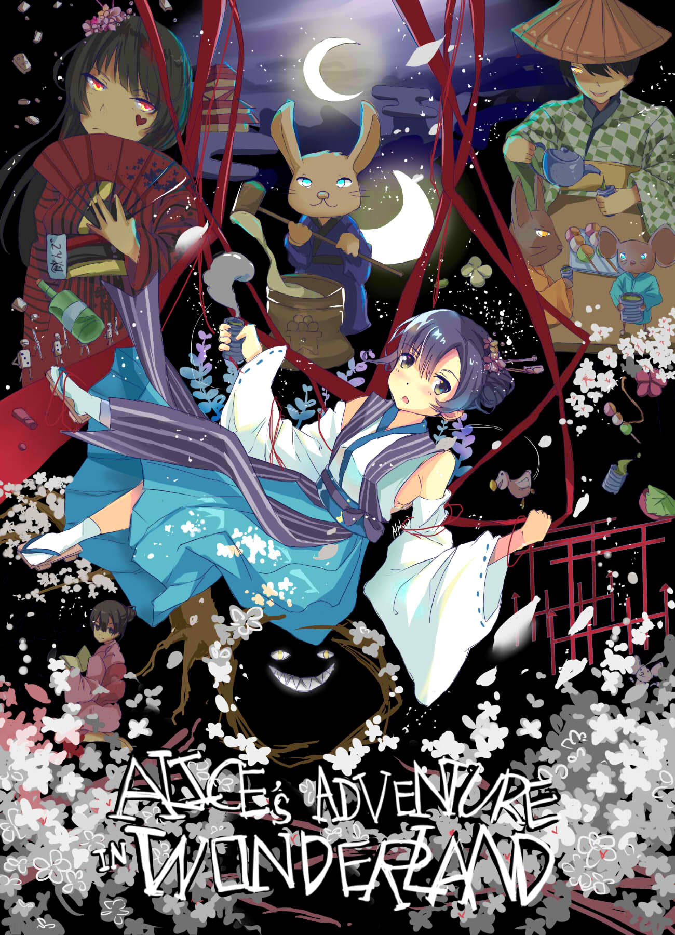
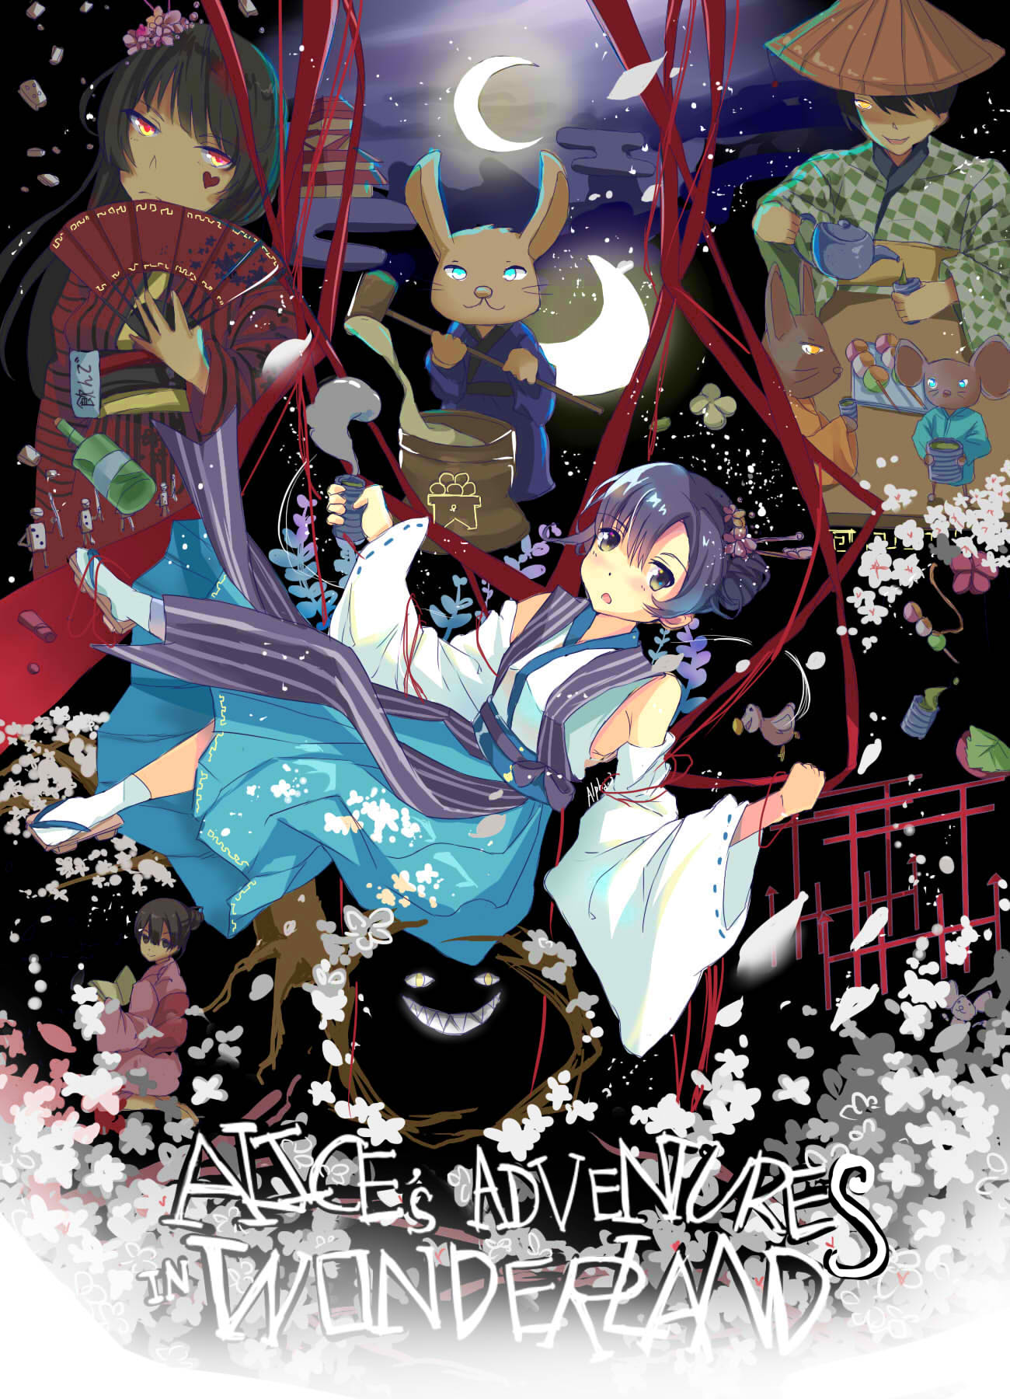
Finish!
Week 3 : DECORATE

Slide 9
REFLECTION: Conflict: the poster show the conflict by show that Alice is falling down, that’s mean she is falling down into the rabbit hole. And that is how the main conflict of the story. Symbolism: - the cute rabbit is a symbol of desire. - the queen of hearts is in the red and black cloth represent as something violent. Theme: my theme is chaos, so, I put many characters and conflicts on my poster

Slide 11
Thank you

