Slide 1
Alcohol and Ether
(R-OH) and (R-O-R)

Slide 2
Members
Smita Jirayingcharoen (Mudmee)
Pattraporn Kheerinpharadorn (BB)
Sumanas Chamneandamrongkarn (Punpun)
Vetaka Prajakchaikul (Ting-Ting)
Sidaporn Muangsiri (Kaimod)

Slide 3
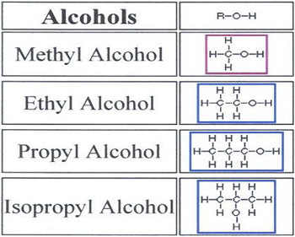
Alcohol
Alcohols are compounds that have one or more hydrogen atoms in an alkane. They have been replaced by an -OH group.

Slide 4
The different types of Alcohol
Alcohol’s classes depend on the position of -OH group on the carbon atom’s chain.
Primary Alcohol
Secondary Alcohol
Tertiary Alcohol

Slide 5
Alcohol
Primary Alcohol
A primary alcohol, the carbon which contains -OH group, attaches with one alkyl group.

Slide 6
Alcohol
Secondary alcohol
A secondary alcohol, the carbon which contains -OH group, attaches with two alkyl groups.

Slide 7
Alcohol
Tertiary Alcohol
A tertiary alcohol, the carbon which contains -OH group, attaches with three alkyl groups

Slide 8
How to name
Counting the carbon atom
Code | No of Carbons
meth | 1
eth | 2
prop | 3
but | 4
pent | 5
hex | 6

Slide 9
How to name
Types of Carbon-Carbon bonds
Code | mean
-an | One carbon-carbon bond
-en | Two carbon-carbon bond

Slide 10
Examples
Pentane
A methyle (CH₃)
2-methylepentane

Slide 11
Examples
Butane
A methyle (CH₃)
2,3-dimethylebutane

Slide 12
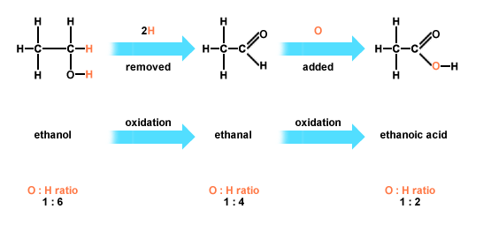
Reaction
Oxidation: Lossing of H2, but adding of O or O2.
Reduction: Adding of H or H2, but losing of O or O2.

Slide 13
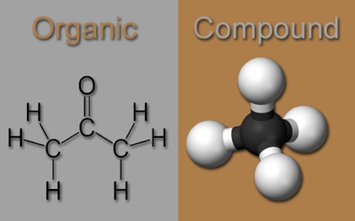
Function
Alcohols are organic compounds. They are mostly used as sweeteners and in making perfumes. Alcohols are valuable in the synthesis of other compounds. They are the most used to produce organic chemicals in industry. The two best-known of alcohols are ethanol and methanol (or methyl alcohol).

Slide 14
Function
Ethanol is used in toiletries, pharmaceuticals, and fuels, and it is used to sterilize hospital instruments.
Methanol is used as a solvent, as a raw material for the manufacture of formaldehyde and special resins, in special fuels, in antifreeze, and for cleaning metals.

Slide 15
Ethers
Ethers are compounds having two alkyl or aryl groups.They bonded to an oxygen atom. The ether functional group does not have a characteristic IUPAC nomenclature suffix. It is necessary to become a substituent.
Structure:
*where the symbols "R₁" and "R₂" represent organic radicals
Ethers are used as solvents for an organic compounds and reactions. They are relatively unreactive. In the exception of the alkanes, cycloalkanes and fluorocarbons, ethers are the least reactive.

Slide 16
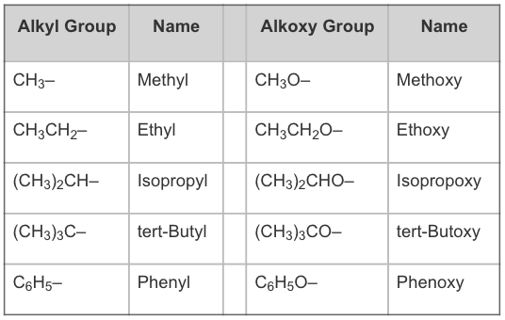
Different types of Ethers
The numbering priority is given to the carbon closest to the oxygen. The alkoxy side has an "-oxy" as a corresponding alkyl group.

Slide 17
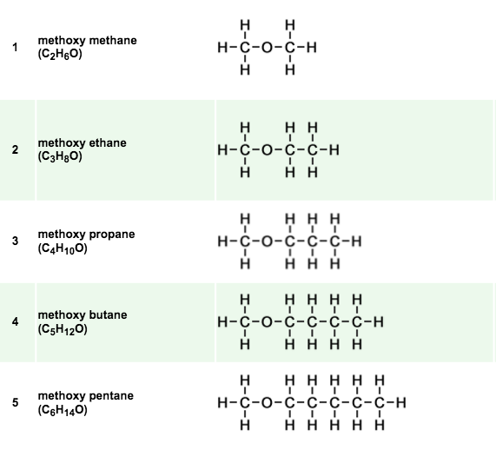
Follow alphabet
Example : "methoxy ethane" = "ethyl methyl ether"
If two sides are the same, define O as ethers
Example : dimethylether

Slide 18
Reaction
Cleavage
Ethers are good solvents because they are not very reactive. Most ethers can be split. In this reaction, hydrobromic acid (HBr) need to give alkyl bromides or hydroiodic acid (HI) need to give alkyl iodides.

Slide 19
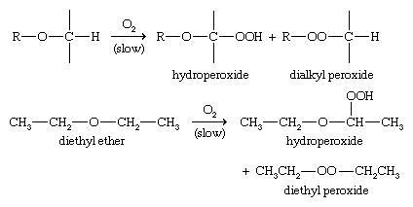
Reaction
Autoxidation
Autoxidation is the oxidation of a compound in air. In the presence of oxygen, ethers slowly autoxidize to form hydroperoxides and dialkyl peroxides. If heated, these peroxides may explode. Ethers should be in small quantities, kept in sealed containers, and used carefully.

Slide 20
Function
Ethers used in pharmacology and medicine, especially for anaesthetics during 1800s. It can be used in an effective pain-relieving drug, and it is a primary ingredient in morphine.
It can also used as a starter fluid for diesel engines and gasoline engines in cold weather.

Slide 21
Question?

Slide 22
What is the structure of Ether?

Slide 23
Which Structure is Ethers and Alcohols ?

Slide 24
What should you add to make ethane become ethanol of the name of the hydrocarbon ?

Slide 25
How many different types of Alcohol?
What are they?

Slide 26
What is the compounds that have one or more
hydrogen atoms in an alkane?

Slide 27
What are the benefit of Alcohol and Ether?

Slide 28
References
Reusch, W. (n.d.). Nomenclature of Ethers. Retrived from
http://chemwiki.ucdavis.edu/Core/Organic_Chemistry/Ethers/Nomenclature_of_Ethers
Reusch, W. (2013, May). Reactions of Ethers. Retrieved from
https://www2.chemistry.msu.edu/faculty/reusch/virttxtjml/alcohol2.htm
Clark, J. (2015, October). Introducing Alcohols. Retrived from
http://www.chemguide.co.uk/organicprops/alcohols/background.html

Slide 29
References
Fitzgerald, G. F. (1890). The Ether and Its Functions. Retrived from
http://www.svpvril.com/fitzether.html
Wade, L. G. (n.d.). Ether. Retrieved from
http://global.britannica.com/science/ether-chemical-compound
Clark, J. (2012, November). The Names of Organic Compounds. Retrieved from
http://www.chemguide.co.uk/basicorg/conventions/names.html#top

