Slide 1
J.J.Thomson
Biography and Academic-technical

Slide 2
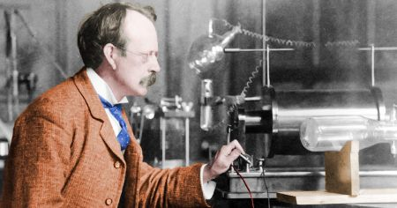
His full name is Joseph John Thomson.
He was an English Physicist.

Slide 3
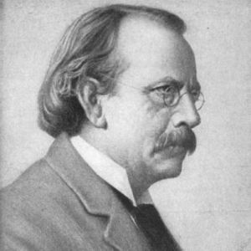
He born on 1856, December 18 in Cheetham Hill, England.

Slide 4
At first, his father who was a bookseller wanted him to be an engineer.
His family could not afford the necessary fee.

Slide 5
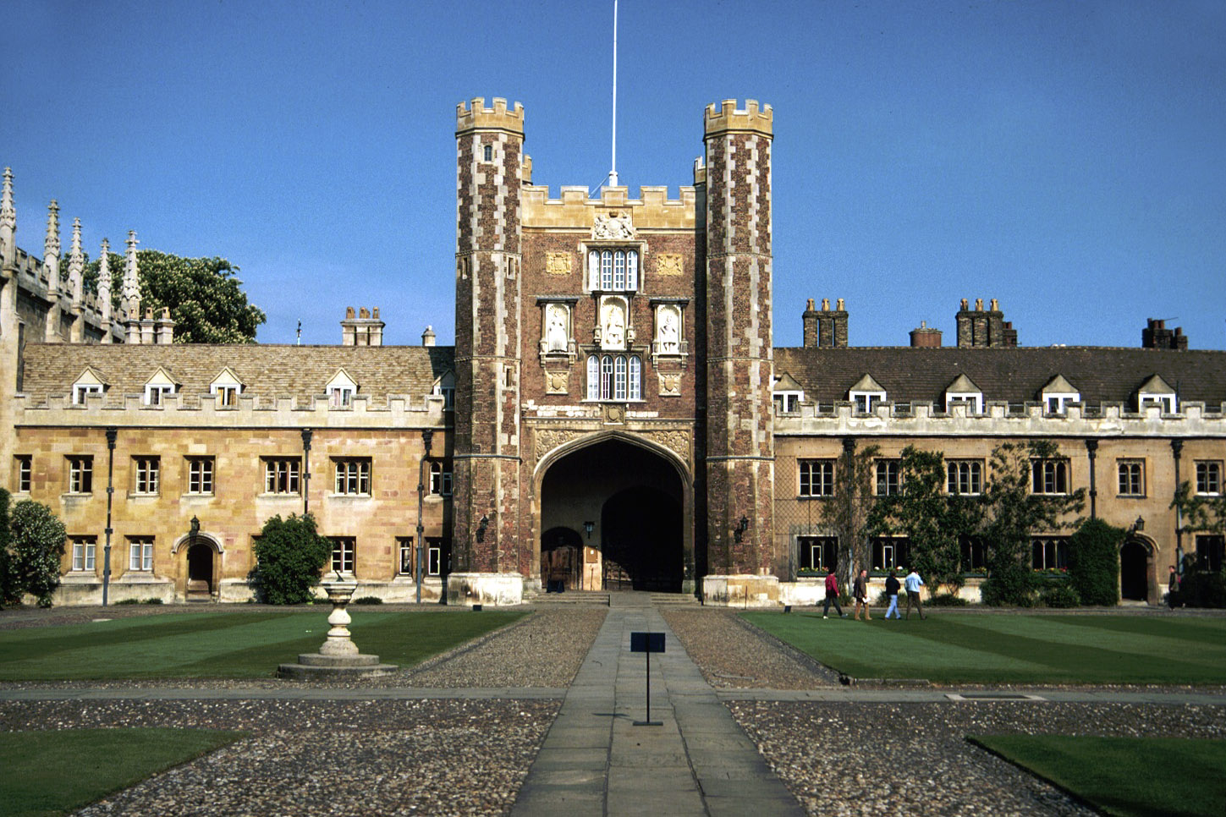
He was invited to Trinity College, Cambridge, then he became a mathematical physicist.
He worked in the Cavendish Laboratory after graduation.
He taught at university and secondary levels.

Slide 6
In 1892, he married Rose Paget, one of his students.
They had one daughter, Joan, and one son, George Paget Thomson.

Slide 7
In 1895, He began to investigate the mysterious rays in electricity was passed through a glass tube.
He believed that cathode or a negative electrical pole in the tube were tiny particles of matter.

Slide 8
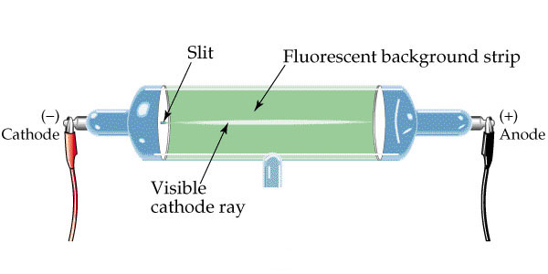
He built a cathode-ray tube which allow the rays passed through electric and magnetic fields. From the direction of their deflection, he decided that particles were negatively charged. These particles were later called “electrons”

Slide 9
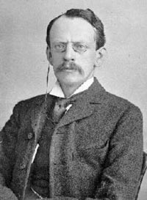
Thomson was also the first person who separate isotopes.

Slide 10
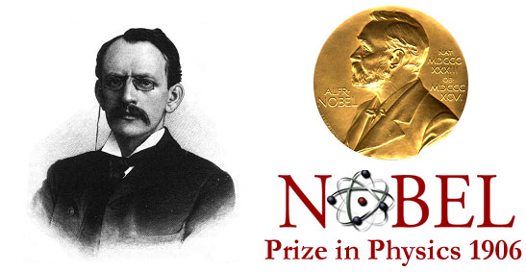
He received the 1906 Nobel Prize in Physics for his discovery of the electron.

Slide 11
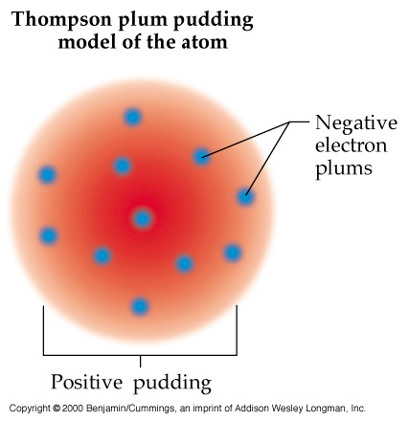
His theoretical model of the atom became obsolete by Ernest Rutherford’s new models.
He published 13 books and more than 200 papers.

Slide 12
Thomson died on 1940, August 30.

Slide 13
References
The Nobel Foundation. (1906). J.J. Thomson – Biographical. Retrieved from www.nobelprize.org/nobel_prizes/physics/laureates/1906/thomson-bio.html
Willard, RR D. (2012, November). The world book encyclopedia. Chicago: World book.

