Slide 1
J.J.Thomson
technical achievements

Slide 2
In 1895, He began to investigate the mysterious rays in electricity was passed through a glass tube.
He believed that cathode or a negative electrical pole in the tube were tiny particles of matter.

Slide 3
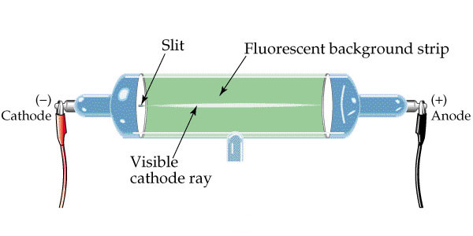
He built a cathode-ray tube which the rays passed through electric and magnetic fields.
It create a vacuum by pump the air out which was different from other kind of cathode ray.

Slide 4
Electrons are produced by travel through a vacuum in high voltage.
It creates a green ray of light at the end of the tube.
It makes a shadow when it travel in a straight line.
From the direction of their deflection, he decided that particles were negatively charged.

Slide 5
Those particles were later called:
“electrons”

Slide 6
He tried to find an evidence of “bodies much smaller than atoms” that he calculated.
The result was it created the value of the charge itself.

Slide 7
He used a “cloud chamber” to present that a cathode ray particle had the same amount of with hydrogen ion.

Slide 8
From the experiment, he found three facts.
First, “Cathode ray particles were negatively charged.”
Second, “Cathode ray particles were at least 1000 times lighter than a hydrogen atom”.
Third, “whatever source was used to generate them, all cathode ray particles were of identical mass and identical charge.”

Slide 9
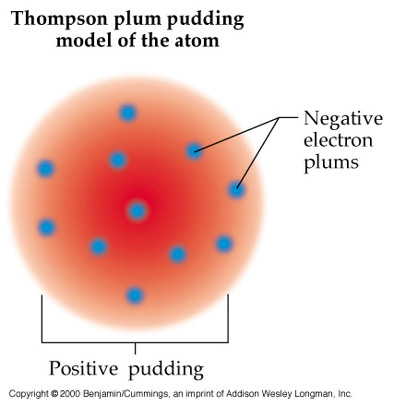
He was the one who created plum pudding model of an atom which is very popular.
He shows the atom as a positively charged ‘pudding’ in the ‘plums’ or an electrons.

Slide 10
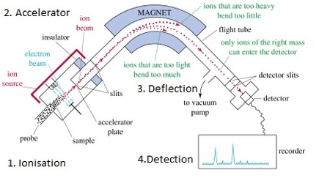
He invented a mass spectrometer. Its beam is made from positive ion.

Slide 11
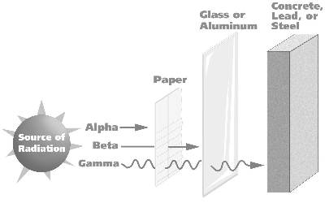
Along with his student Ernest Rutherford, they find the number of electrons in an atom of light, X, beta, and gamma rays.

Slide 12
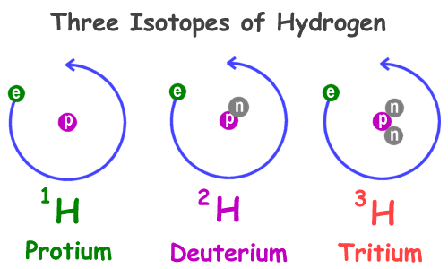
Thomson was also the first person who separate isotopes.
In 1912, Thomson found that a stable element is an isotope.
It means that it must have a different atomic mass.

Slide 13
He published 13 books and more than 200 papers.

Slide 14
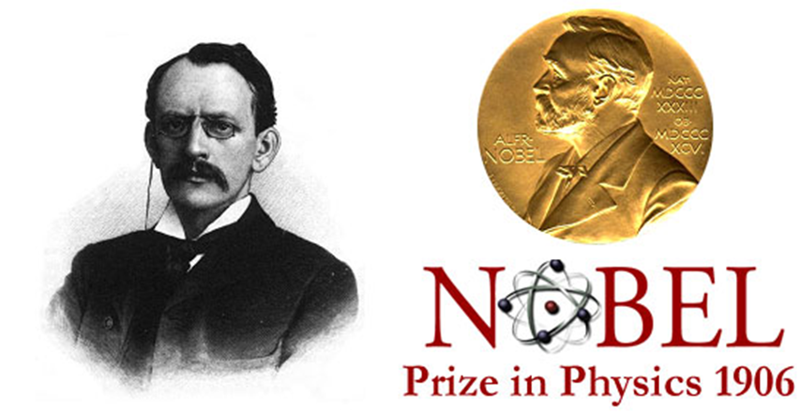
He received the 1906 Nobel Prize in Physics for his discovery about particles of electron.

Slide 15
References
The Nobel Foundation. (1906). J.J. Thomson – Biographical. Retrieved from www.nobelprize.org/nobel_prizes/physics/laureates/1906/thomson-bio.html
Willard, RR D. (2012, November). The world book encyclopedia. Chicago: World book.

